Slide 1
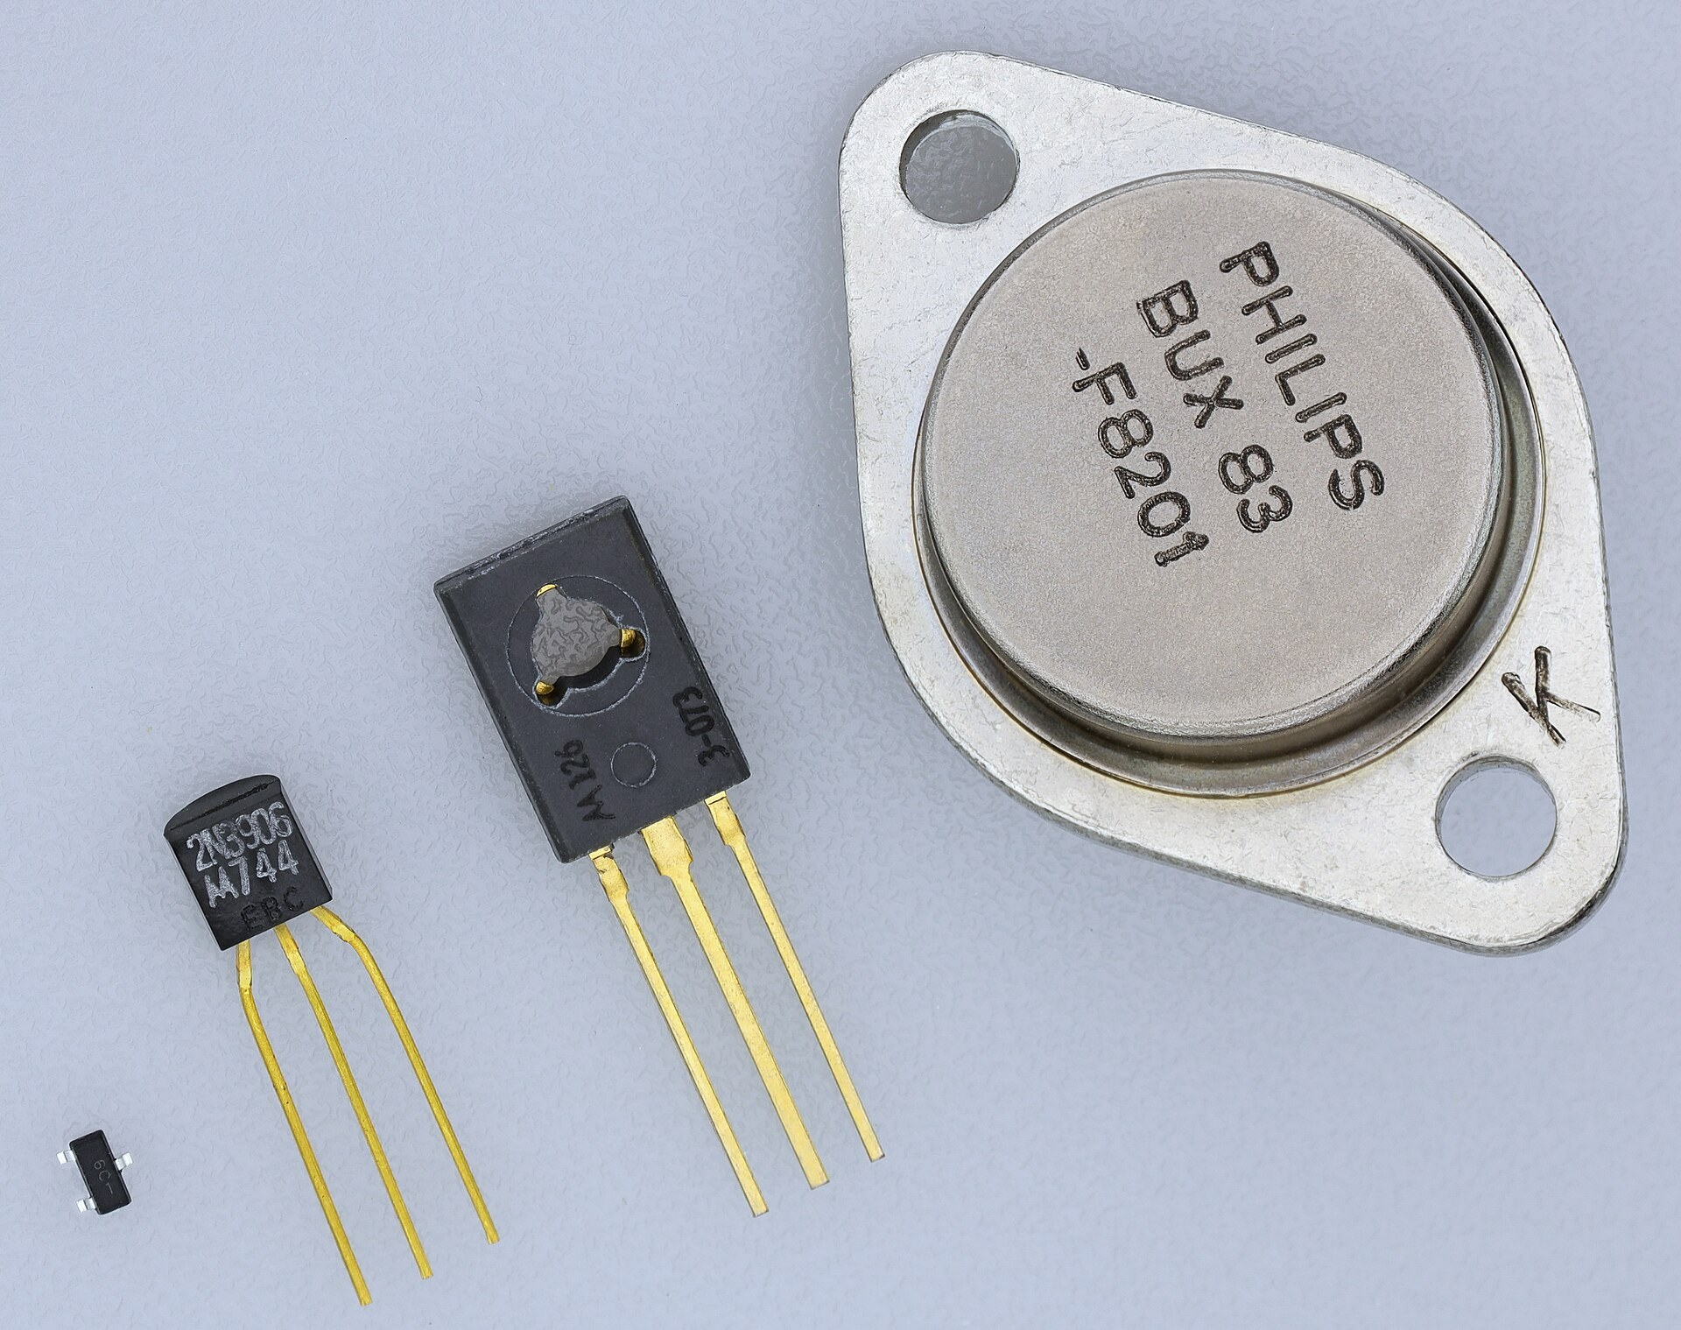
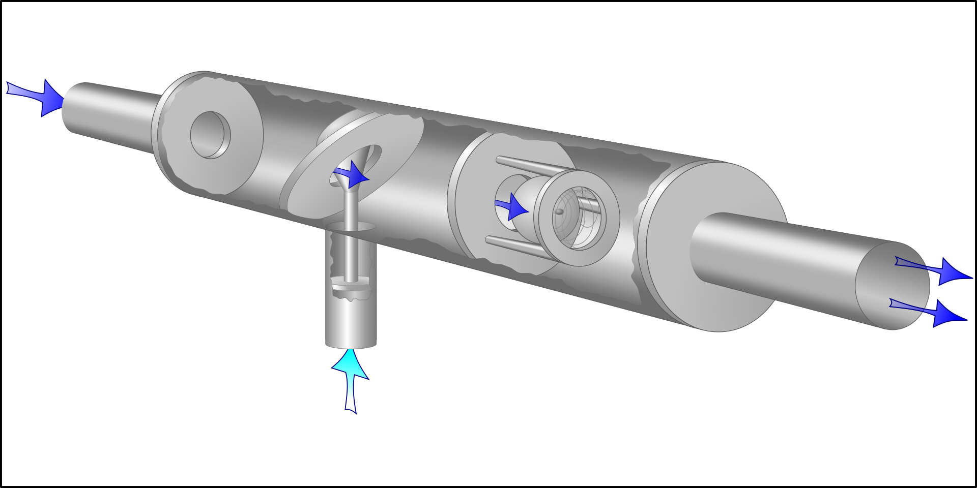
Transistor Fundamentals
What is a transistor?
Transistors are electrically controlled switches
A small signal turns a much bigger flow of electricity ON, OFF, or anywhere in between (known as amplification).
Small-signal: everyday circuits
Water Analogy
A small push from the side pipe opens a valve, letting a far bigger flow through the main pipe.
A transistor does exactly this with electric current.
big main flow
Power transistor: switches big currents (motors, chargers)
small control push
Surface-mount: tiny, for phones
December 1947
Bell Labs develops the first point-contact transistor
>13 sextillion
Transistors fabricated since their invention; the most manufactured device in history
Today:
1 P-N junctions
2 BJT
3 MOSFET
4 Transistor devices
Notes:
SCRIPT (0:00–0:33):
Every phone, laptop and hearing aid runs on one invention: the transistor. Think of it as a tap for electricity. A small push on the control lets a much bigger flow through, just like this water valve. In fact, the very first product ever sold with a transistor, back in 1952, was a hearing aid. Today I'll show you the building block, the P-N junction, then the two main designs, the BJT and the MOSFET, and finally what we build with them.
DEEPER DETAIL (for questions):
- What a transistor does: it is a three-terminal semiconductor device. A small signal on one terminal (BJT base / MOSFET gate) controls a much larger current between the other two. Used as a SWITCH (fully on/off: digital logic, power control) or an AMPLIFIER (output is a scaled-up copy of the input: audio, sensors, radio).
- The water-valve picture is the classic "hydraulic analogy": the light-blue side flow = control signal; the dark-blue main flow = the controlled current.
- History: first transistor demonstrated at Bell Labs in late 1947. The first commercial product to use one was the Sonotone 1010 hearing aid (Dec 1952), chosen because transistors drew far less battery power than vacuum tubes. By 1954, 97% of hearing aids used only transistors (Computer History Museum).
- Scale: an estimated 13 sextillion (1.3 x 10^22) transistors had been made by 2018, 99.9% of them MOS (MOSFET) devices (Computer History Museum / Jim Handy). A modern phone processor holds 15+ billion (Apple A15: 15 bn, A16: 16 bn).
- Photo: the big metal can (a Philips BUX83) is a power transistor for large currents; the small black plastic ones are everyday "through-hole" parts (the smallest, marked 2N3906, is a very common PNP BJT); the black speck is a surface-mount part like those on phone circuit boards.
QUESTIONS THIS SLIDE SETS UP: all of them. It states the purpose and the order of the talk.

Slide 2
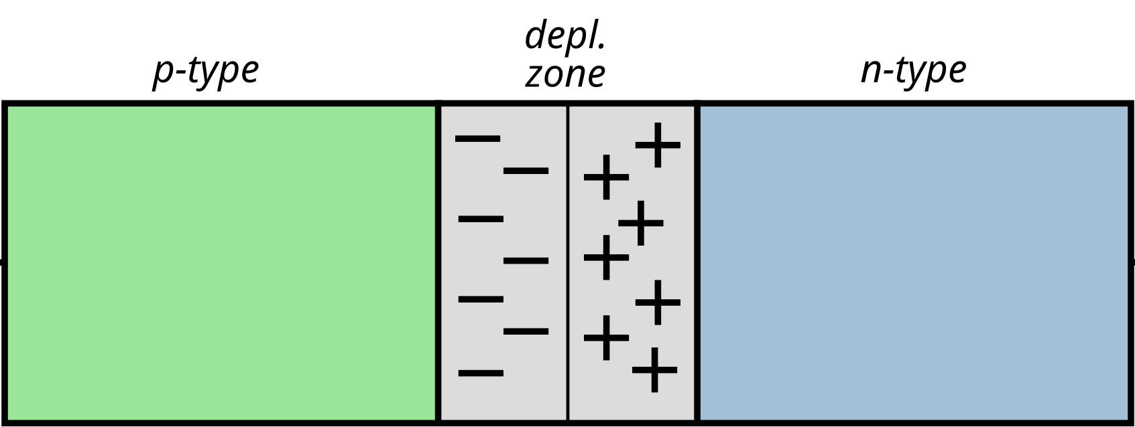
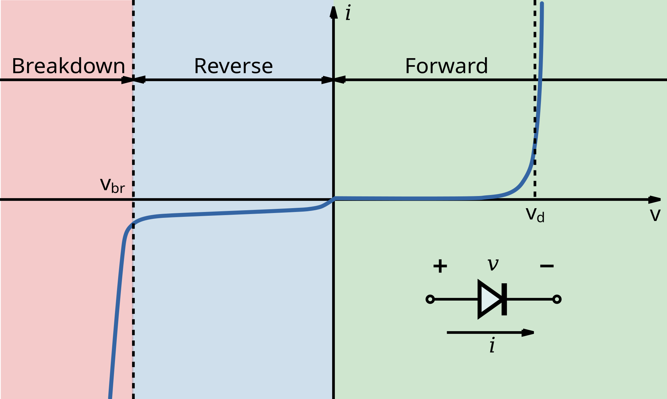

P-N junctions: electricity's one-way valve
To understand transistors, we must first zoom in on the tiny particle “junctions” that they exploit
Where P meets N: the junction
Pushing current through it
Silicon: the base material
Silicon is known as a “semiconductor”.
On its own it barely conducts. Germanium and gallium arsenide are also good examples.
Doping is what makes it useful
holes (+)
free electrons (−)
N-type = silicon + phosphorus
Adds spare electrons that are free to move: Negative charge carriers.
Depletion region: electrons cross the border and fill nearby holes, leaving a zone with no free charges.
It acts like a wall.
P-type = silicon + boron
Leaves “holes”: gaps where an electron is missing. They act like moving Positive charges.
Forward bias: + on the P side shrinks the wall, so current flows (above ≈0.7 V in silicon)
Why does the wall form? Electrons spread out like ink in water. The atoms they leave behind are charged, and their electric field pushes back until crossing stops.
Reverse bias: the wall widens and blocks the current
Breakdown: push hard enough backwards and it gives way
Adding a pinch of another element is called doping
P-N junctions are like one-way turnstiles. Transistors are two of them back-to-back. Controlling the wall controls the current.
Notes:
SCRIPT (0:33–1:09):
Transistors are made from silicon. On its own it barely conducts, so we add a pinch of another element. This is called doping. Phosphorus gives spare electrons, which we call N-type. Boron leaves gaps called holes, which we call P-type. Where they meet, electrons fill the nearby holes, leaving an empty zone that acts like a wall: the depletion region. Push forwards and the wall shrinks, so current flows. Push backwards and it widens, blocking it. It's a one-way valve, and controlling that wall is the secret of every transistor.
DEEPER DETAIL (for questions):
Q: What are P-N junctions? The boundary inside one crystal where P-type semiconductor meets N-type. It is the basic building block of diodes, BJTs and MOSFETs.
Q: Materials for P and N regions? The host crystal is usually SILICON (cheap, abundant, and it grows a superb insulating oxide, SiO2, which MOSFETs depend on). GERMANIUM was used in the first transistors (smaller bandgap, leakier when hot). GALLIUM ARSENIDE is used for very high-frequency radio chips and LEDs; silicon carbide and gallium nitride are used for high-power devices.
N-type dopants (group V, five outer electrons): phosphorus, arsenic, antimony. The 5th electron is spare and free to move.
P-type dopants (group III, three outer electrons): boron, aluminium, gallium. The missing bond electron is a "hole" that behaves like a positive carrier.
Doping levels are tiny: roughly 1 dopant atom per million to per billion silicon atoms.
Q: Why does a depletion region form? Diffusion: electrons are crowded on the N side and holes on the P side, so each spreads into the other side (like ink in water) and they recombine near the boundary. That leaves behind fixed, charged dopant atoms: positive donor ions on the N side, negative acceptor ions on the P side. Their electric field (the "built-in potential", about 0.6-0.7 V in silicon) pushes back against further diffusion. Equilibrium is reached when the field's push balances diffusion, leaving a thin layer emptied ("depleted") of free carriers, which is the barrier.
Q: Forward vs reverse bias? FORWARD (+ to P, - to N): the external voltage opposes the built-in field, so the depletion region narrows and current rises roughly exponentially once about 0.6-0.7 V is applied (silicon). REVERSE (+ to N): the field is reinforced, the region widens and only a tiny leakage current flows, until breakdown (avalanche or Zener) at a large reverse voltage.
Q: Why is this helpful for transistors? A transistor is two junctions whose barriers we can control. In a BJT the base-emitter junction is forward biased to inject carriers, and the collector-base junction is reverse biased so its strong field sweeps those carriers into the collector. In a MOSFET the source and drain junctions are reverse biased to the body, isolating the device so current can only flow through the gate-controlled channel.
GRAPH: the green zone is forward bias, blue is reverse bias, red is breakdown. This curve is also the BJT's INPUT characteristic, because the base-emitter junction is a diode.

Slide 3
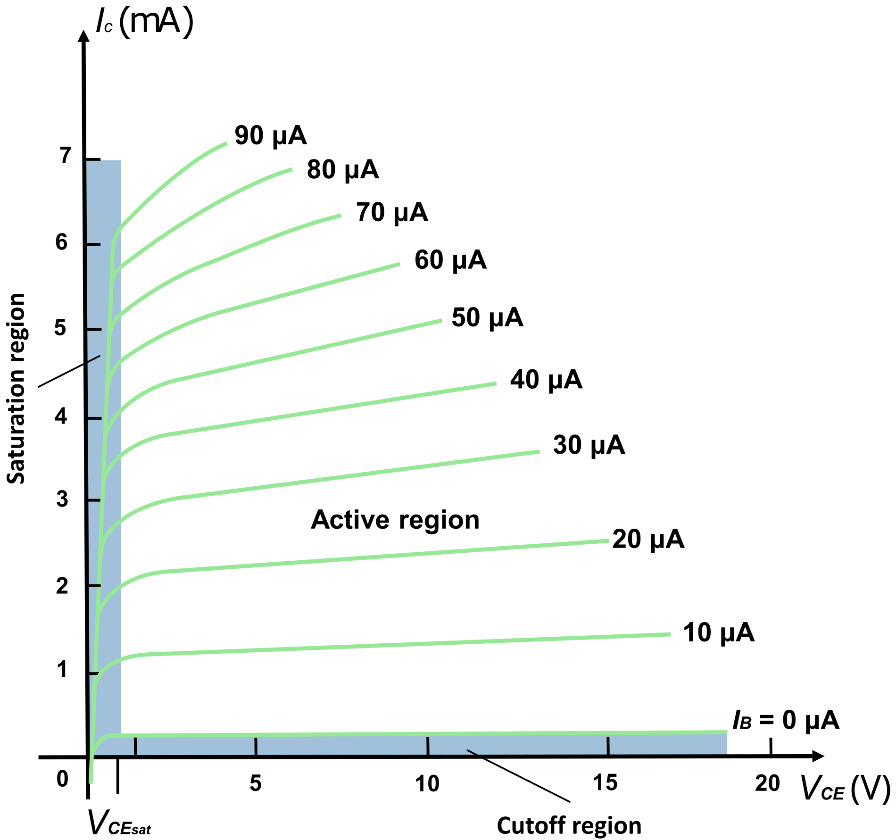
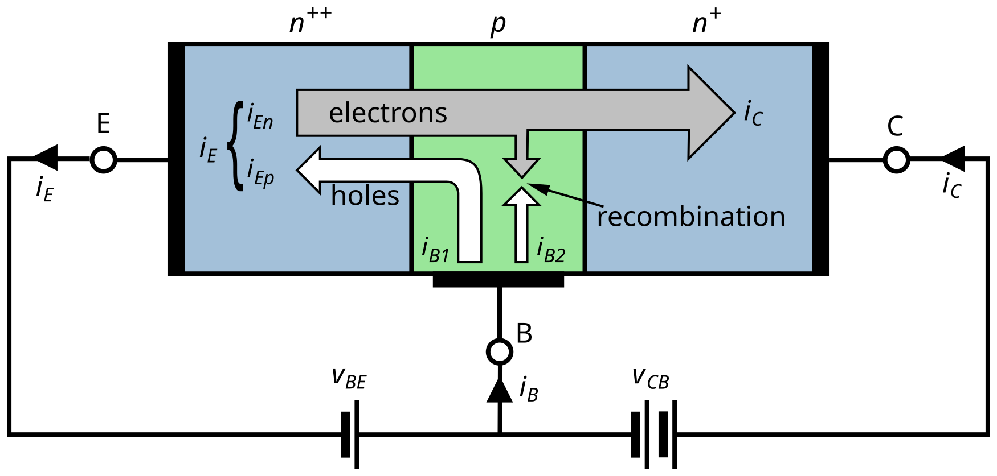
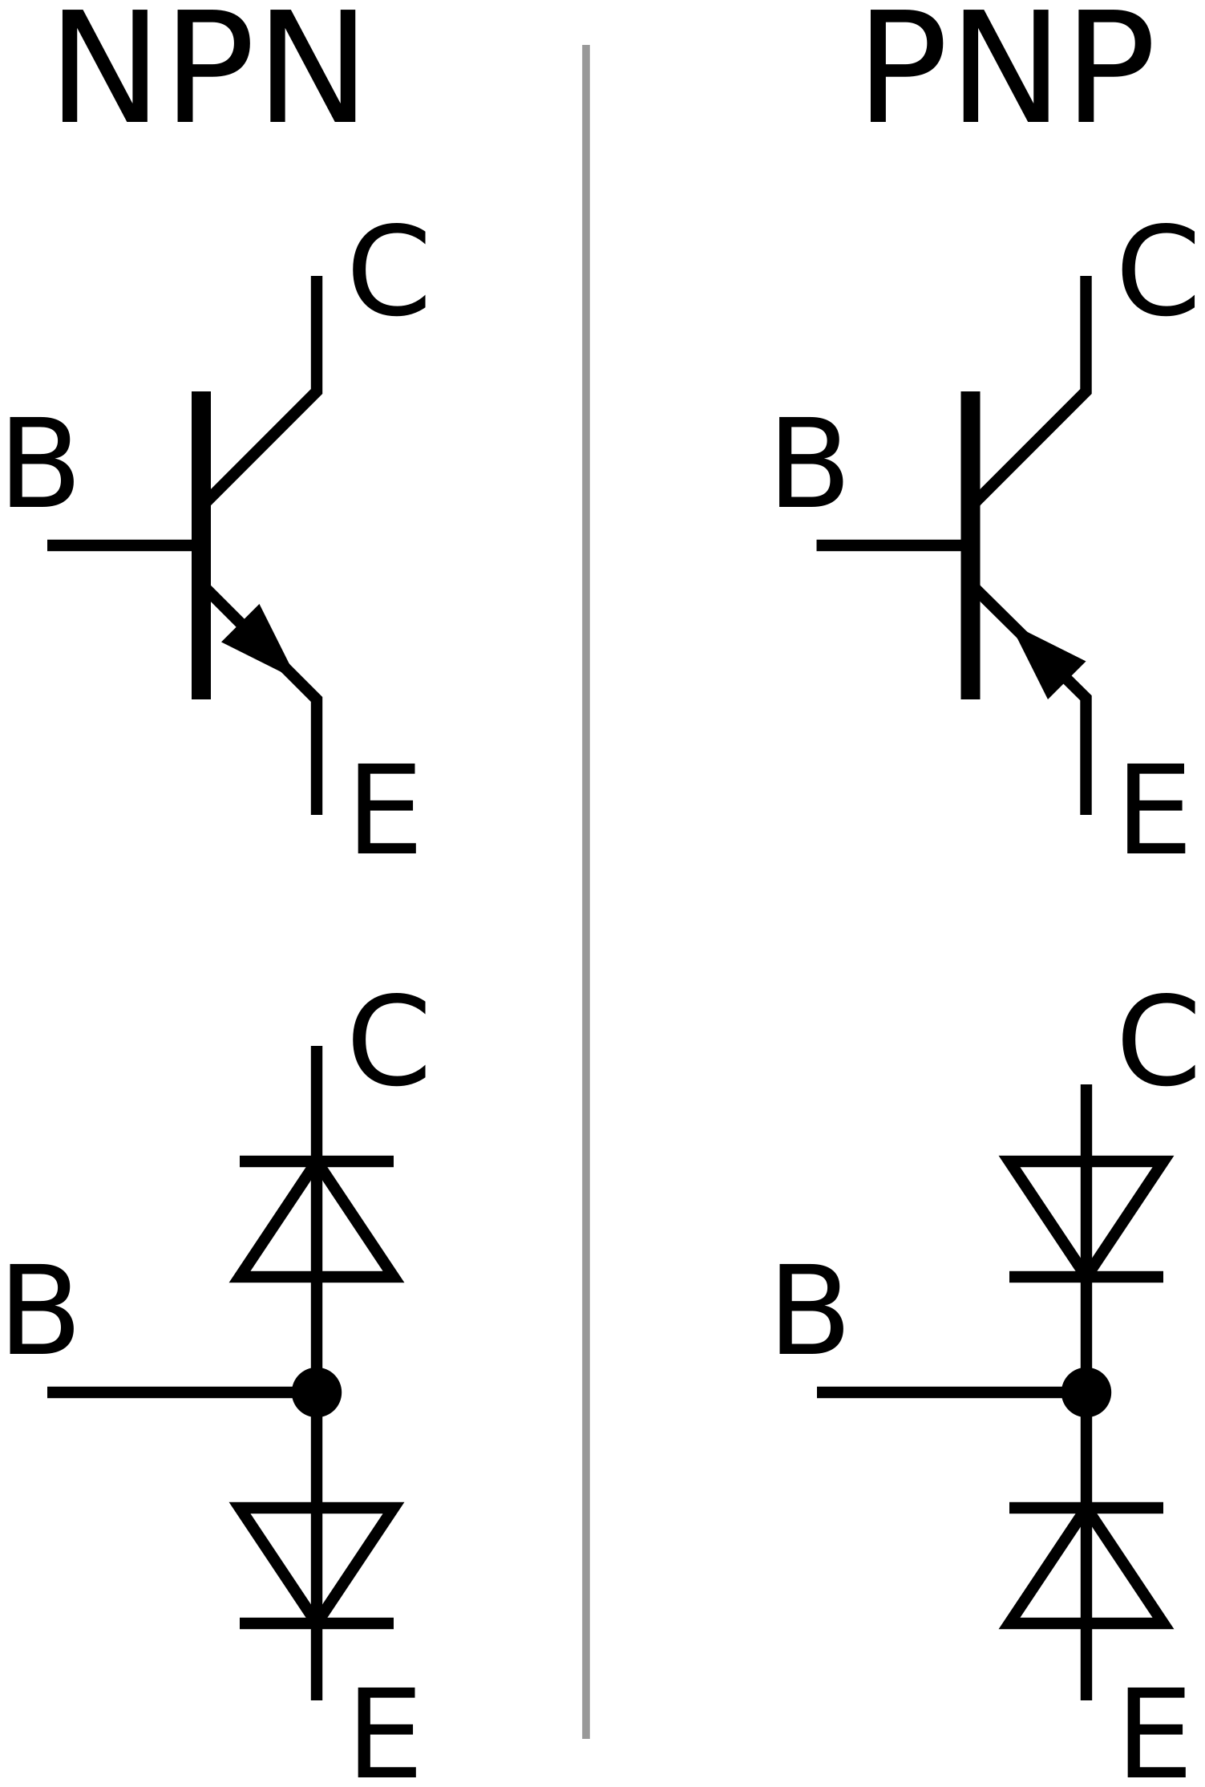
Bipolar Junction Transistors: a small current controls a big one
BJT = Bipolar Junction Transistor. “Bipolar” because both electrons and holes carry the current
EMITTER heavily doped, a huge crowd of electrons
BASE very thin, lightly doped. 99% of electrons fly straight through
COLLECTOR largest, moderately doped: collects them and copes with high voltage
SATURATION: fully ON, a closed switch (LEDs, motors, logic)
ACTIVE: an amplifier.
Output ≈ input × 100 (audio, hearing aids)
CUT-OFF: no base current, OFF: an open switch
NPN vs PNP: each is two P-N junctions back to back (bottom drawings).
NPN (most common): electrons carry the current, about 3× faster than holes. A positive base signal switches it ON.
PNP (mirror image): switched ON by pulling the base low. Used to switch the + supply and paired with NPN in audio amplifiers.
A tiny base current (µA) lets a ~100× bigger current (mA) flow through
BJTs are best understood as like electrical taps.
A gentle twist of the handle (base) controls a powerful flow (collector).
Notes:
SCRIPT (1:09–1:43):
Our first transistor, the BJT, is a three-layer sandwich, N-P-N or P-N-P: two of those valves back to back. The emitter is packed with electrons. The base is very thin and lightly doped, so when a tiny current flows into it, a flood of electrons shoots straight through to the collector, about a hundred times more. Fully off or fully on, it's a switch. In between, in active mode, it's an amplifier. NPN is most common because electrons are faster. PNP is its mirror image.
DEEPER DETAIL (for questions):
Q: What are NPN and PNP? Three-layer sandwiches: N-P-N (P-type base between two N regions) or P-N-P. Each equals two diodes back to back, but the very thin shared base makes them interact. That is the transistor action.
NPN: the current is carried mainly by electrons, whose mobility in silicon is about 3x that of holes (about 1400 vs 450 cm^2/Vs), so NPNs are faster and give more gain for the same size. That is why they are the most common. Used as "low-side" switches (between the load and ground), turned on when the base is about 0.7 V above the emitter.
PNP: the current is carried by holes. Turned on by pulling the base about 0.7 V below the emitter. Used as "high-side" switches (connecting a load to the positive supply), in current sources and mirrors, and paired with NPN in "complementary push-pull" audio output stages.
Q: Doping and size of each region, and why?
EMITTER: very heavily doped (about 10^19-10^20 atoms/cm^3) so that almost all current across the base-emitter junction is electrons injected into the base, not holes coming back ("high emitter injection efficiency").
BASE: lightly doped (about 10^16-10^17) and very thin (well under a micrometre in modern parts). With few holes and a short path, very few injected electrons recombine, so about 99% reach the collector (alpha of about 0.99, current gain beta = alpha/(1-alpha) of about 100; typically 50-300).
COLLECTOR: the largest region, moderately to lightly doped (about 10^15-10^16). Light doping gives a wide depletion region, so it withstands high voltages. The large size collects carriers and spreads heat.
This asymmetry is why swapping emitter and collector ("reverse active" mode) gives very poor gain.
Q: How does a small base current control a large collector current? The base-emitter voltage lowers the barrier, letting the emitter flood the thin base with electrons. Because the base is thin and lightly doped, almost none recombine. They diffuse to the reverse-biased collector junction, whose field sweeps them into the collector. The small base current only needs to replace the few holes lost to recombination. Ic = beta x Ib.
Q: Operating modes:
CUT-OFF: both junctions reverse biased. Ic is about 0, an OPEN switch.
ACTIVE (forward active): BE forward, CB reverse. Ic = beta x Ib, an AMPLIFIER (audio, hearing aids, sensors, radio).
SATURATION: both junctions forward biased. Ic is limited by the circuit and Vce is about 0.2 V, a CLOSED switch (driving LEDs, relays, motors, logic).
REVERSE ACTIVE: BE reverse, CB forward. Low gain and rarely used.
Q: I/O characteristics (graph): INPUT is Ib vs Vbe, an exponential diode curve (about 0.7 V turn-on, see slide 2). OUTPUT is Ic vs Vce for steps of Ib. The flat lines are the active region (Ic set by Ib, not Vce; the slight slope is the "Early effect"). The steep strip near Vce = 0 is saturation; the bottom line (Ib = 0) is cut-off. In this graph, 90 uA in gives about 7 mA out, a gain of roughly 80x.

Slide 4
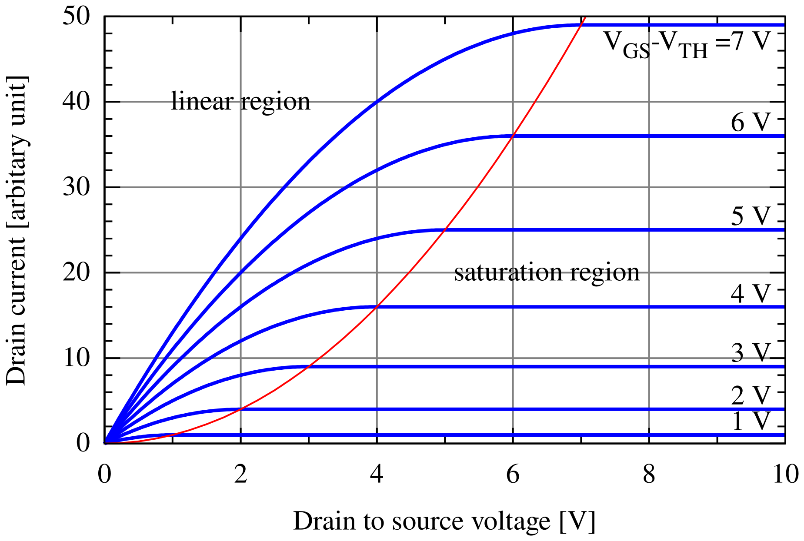
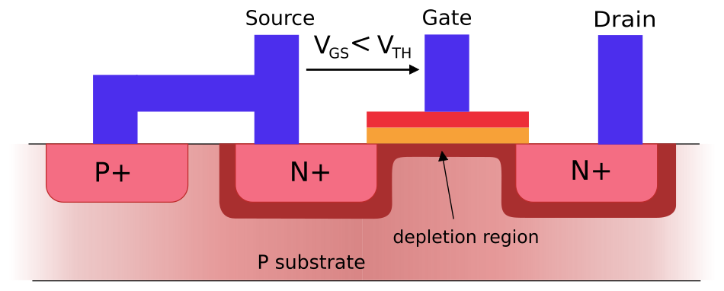
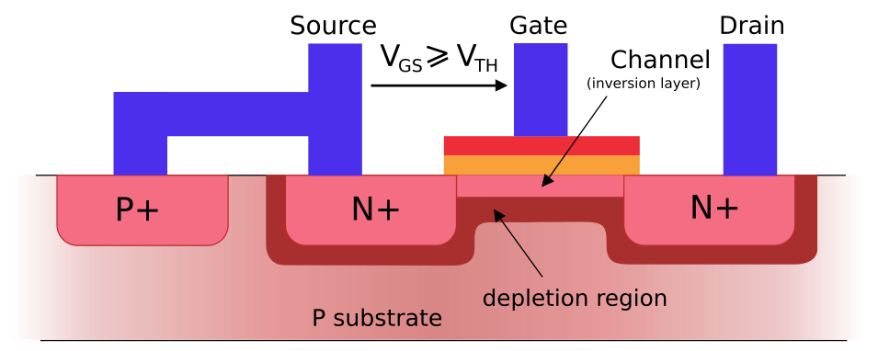
MOSFETs: switched by an electric field
MOSFET = Metal-Oxide-Semiconductor Field-Effect Transistor: a metal gate on a thin layer of glass (oxide) over silicon
OFF: gate voltage too low
ON: gate voltage above threshold
Each line: a higher gate voltage gives more current
LINEAR: fully ON, acts like a closed switch
SATURATION: gate sets the current, used to amplify
Glass (oxide) layer: almost no current flows into the gate
Electric field pulls electrons up, forming a bridge (channel) from source to drain
How we rate a MOSFET
Threshold voltage (Vth)
Gate voltage needed to turn ON.
Must suit what drives it.
On-resistance (RDS(on))
Resistance when ON.
Lower means less energy wasted as heat.
Head to head | MOSFET | BJT
Controlled by | Voltage (electric field) | Current
Power to control it | Almost none ✔ | Small but constant
Shrinks to billions per chip | Yes ✔ 99.9% of all transistors made | Harder
Weak spot | Static electricity can damage the glass layer | Wastes control power; can overheat
Best for | Computer chips, chargers, power supplies | Low-noise amplifiers, sensors ✔
Switching speed
How fast it flips ON/OFF.
Vital for fast chips and chargers.
Voltage & current limits
The most it can take before it is damaged.
The gate works like a magnet, pulling electrons into a bridge without touching them.
Notes:
SCRIPT (1:43–2:14):
The MOSFET works differently. Its control, the gate, sits on a thin layer of glass, so almost no current flows into it. Instead, a gate voltage creates an electric field that pulls electrons to the surface, forming a bridge, called a channel. We rate MOSFETs on switch-on voltage, resistance when on, speed and their limits. Needing almost no control power, and shrinkable to nanometres, they're 99.9 percent of all transistors ever made. BJTs still win for low-noise amplifiers.
DEEPER DETAIL (for questions):
Q: What is a MOSFET? Metal-Oxide-Semiconductor Field-Effect Transistor. Terminals: gate, source, drain (and body). The gate is a conductor (originally metal, now often polysilicon or metal) separated from the silicon by a very thin insulating oxide (SiO2 or "high-k" materials). Types: n-channel (NMOS) and p-channel (PMOS); enhancement-mode (normally OFF, the usual kind) and depletion-mode (normally ON).
Q: How does it use an electric field? The gate, oxide and silicon form a capacitor. In an n-channel device on a P-type body, a positive gate voltage pushes holes away from the surface (first forming a depletion region) and then attracts electrons. Above the THRESHOLD VOLTAGE, enough electrons gather to form an "inversion layer": an N-type channel linking the N+ source and drain. More gate voltage gives a richer channel and more current. No DC current flows through the oxide, so control is by field (voltage) alone.
Q: Important device characteristics, and why they matter:
Threshold voltage, Vth: the gate voltage at which it turns on. It must match the driving logic (for example 3.3 V microcontrollers need "logic-level" MOSFETs).
On-resistance, RDS(on): resistance when fully on. Lower means less I^2R heat loss and better efficiency in chargers and power supplies.
Gate charge / input capacitance (Qg, Ciss): sets switching speed and how much drive current is needed. This matters for fast processors and high-frequency converters.
Maximum drain-source voltage V(BR)DSS, maximum drain current ID, and power dissipation / thermal resistance: the safe operating limits.
Transconductance, gm: change in drain current per volt of gate voltage. It sets amplifier gain.
Leakage current (IDSS / subthreshold leakage): current when OFF. It drains batteries in phones and laptops.
Q: Advantages vs BJT: voltage-controlled with near-zero static gate current (very high input impedance); tiny control power; easy to make in huge numbers on a chip (CMOS), which is why 99.9% of all transistors made are MOS; fast switching (no stored minority charge); very low RDS(on) for power; positive temperature coefficient, so they share current when paralleled and avoid thermal runaway.
Disadvantages vs BJT: the thin gate oxide is easily destroyed by static electricity (ESD); gate capacitance must be charged and discharged, so fast switching needs strong drivers; lower transconductance per unit current (less gain); more low-frequency (1/f) noise; threshold voltage varies between parts. BJTs need constant base current, have lower input impedance and can suffer thermal runaway, but they excel in low-noise, high-precision analogue circuits.
Q: I/O characteristics (graph): INPUT: no DC gate current; drain current is about 0 below Vth, then rises roughly with (VGS - Vth)^2. OUTPUT (graph): ID vs VDS for several gate voltages. LINEAR (ohmic) region at small VDS: it behaves like a voltage-controlled resistor and is used as a closed switch. SATURATION region: the current is set by VGS and is almost independent of VDS, used for amplifying.
WATCH OUT: "saturation" means opposite things! BJT saturation = fully ON switch. MOSFET saturation = the constant-current amplifying region (like the BJT's ACTIVE mode).

Slide 5
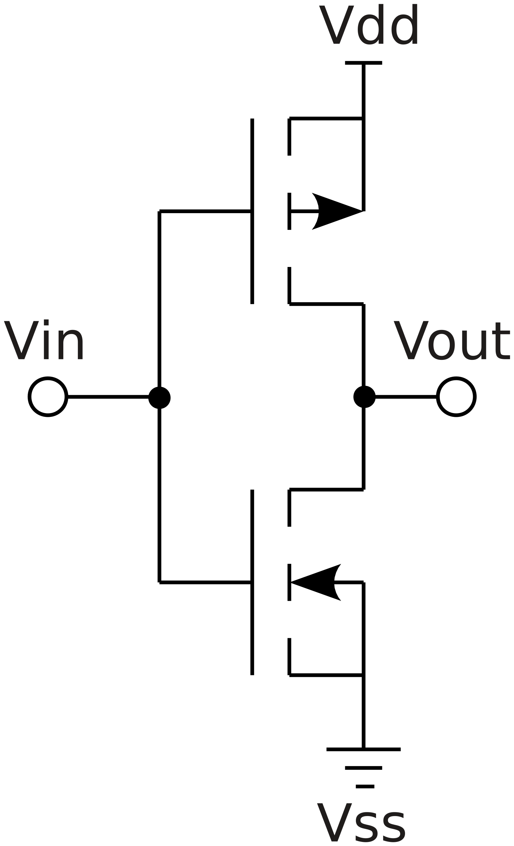
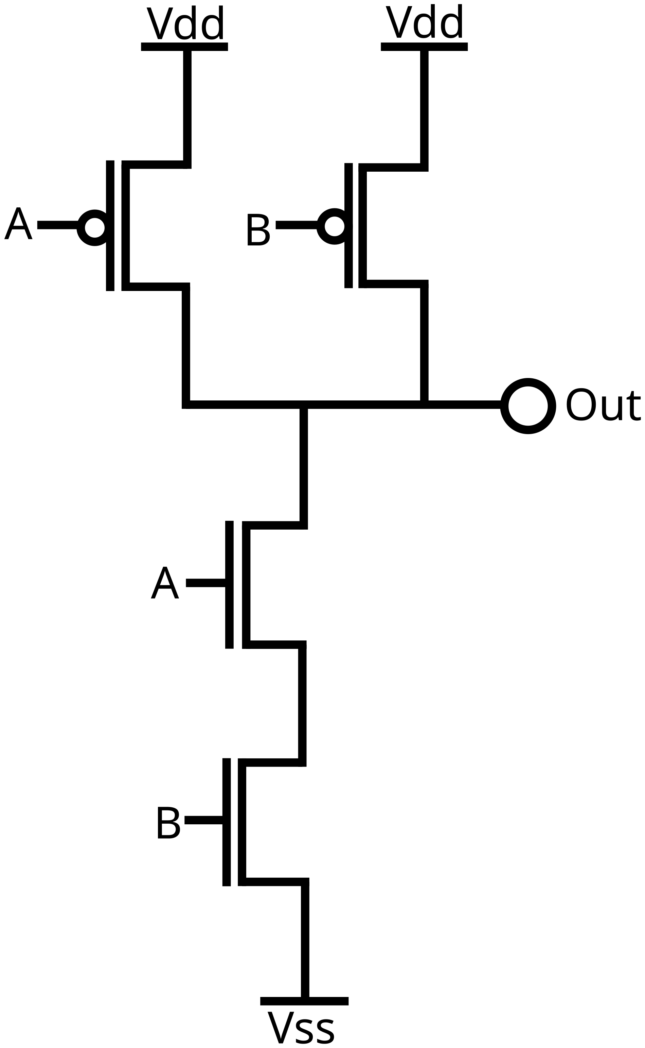
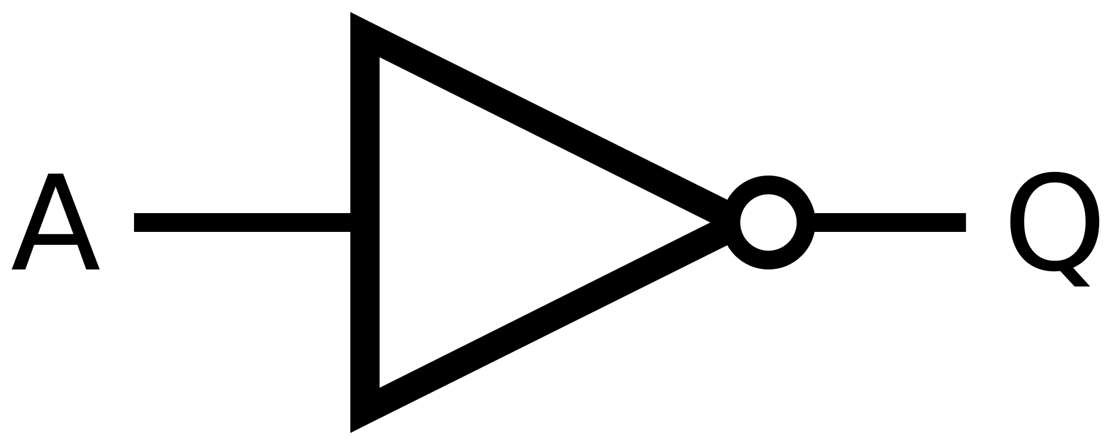
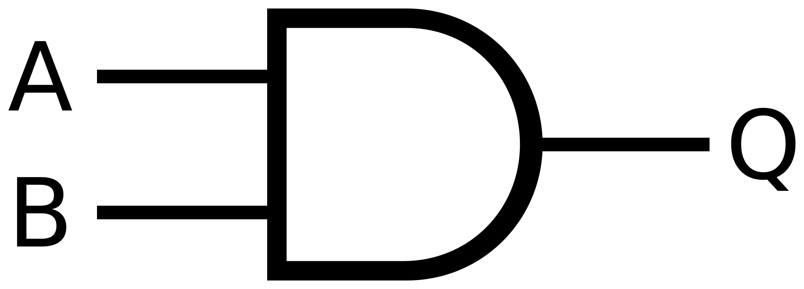
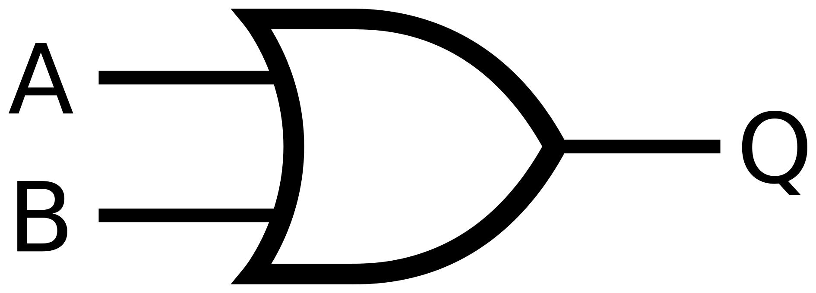

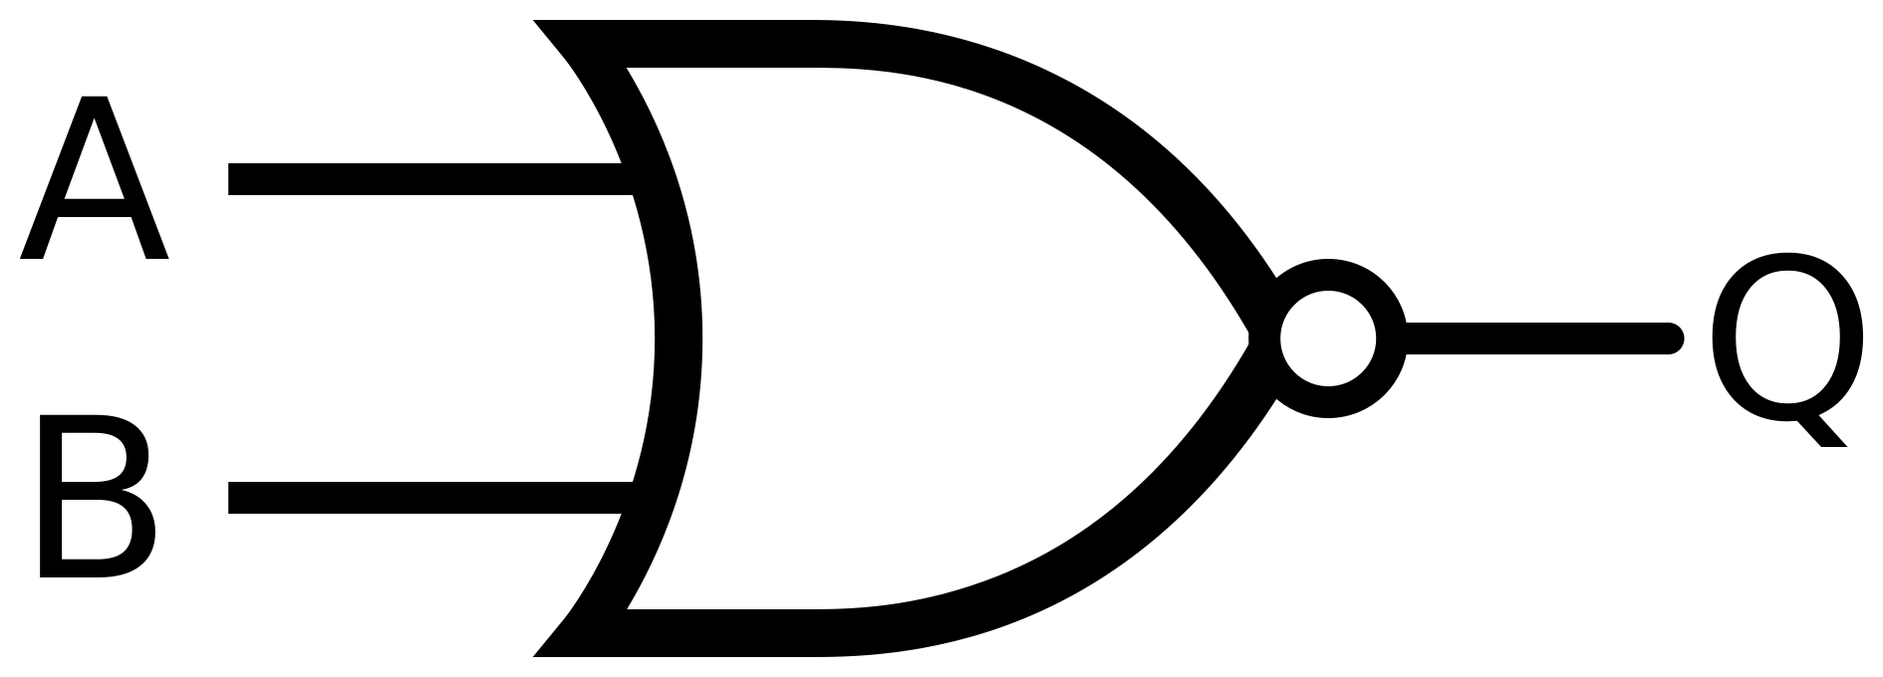
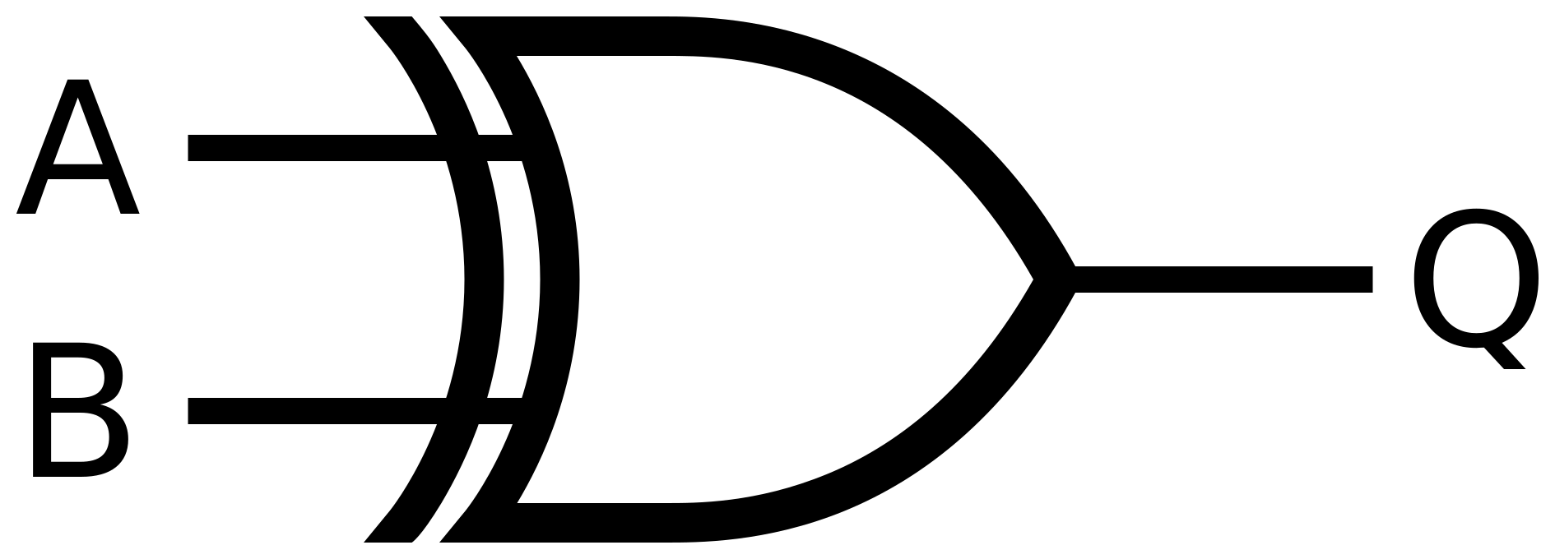
Transistor devices: from tiny switches to computers
Logic gates, made from transistors, are the binary decision-makers inside every chip. 1 = ON (voltage), 0 = OFF
NOT gate (2 transistors)
NAND gate (4 transistors)
The family of gates
transistors
Top (P-type): ON when input = 0, linking output to the supply (Vdd) = 1
PARALLEL (top): either switch can link output to 1. Works like OR
NOT Output is the opposite of the input
2
AND 1 only if both inputs are 1
6
Bottom (N-type): ON when input = 1, linking output to ground (Vss) = 0
SERIES (bottom): both must be ON to link output to 0. Works like AND
OR 1 if either input is 1
6
NAND 0 only if both inputs are 1
4
NOR 1 only if both inputs are 0
4
Output is always the opposite of the input
Output is 0 only when A AND B are both 1
XOR 1 if the inputs differ (4 NANDs)
16
Transistor
a switch
Logic gate
a decision
Adders & memory
maths and storage
Processor chip
15+ billion transistors in a phone
Everyday tech
phones, laptops, hearing aids, pacemakers
Notes:
SCRIPT (2:14–2:42):
So what do we build? Logic gates, the decision-makers of computers. Pair two MOSFETs and you get a NOT gate: input on, output off. Transistors in series must both be on, which behaves like AND. In parallel, either will do, which behaves like OR. Combine them into NAND, NOR and XOR, then adders and memory, and you get chips with billions of transistors, in your phone, your laptop, even pacemakers.
DEEPER DETAIL (for questions):
Q: What can we build with transistors? Amplifiers (audio, hearing aids, radio), switches (motor drivers, LED drivers), power converters (phone chargers, laptop supplies), oscillators and clocks, voltage regulators, memory (SRAM uses 6 transistors per bit; DRAM uses 1 transistor + 1 capacitor; flash uses floating-gate MOSFETs), image sensors, and logic gates, which combine into adders, processors and entire computers.
Q: How do transistor logic gates work? Modern chips use CMOS (Complementary MOS). Every gate has a PULL-UP network of P-type MOSFETs (each ON when its input is 0) connecting the output to the supply (logic 1), and a complementary PULL-DOWN network of N-type MOSFETs (each ON when its input is 1) connecting the output to ground (logic 0). Exactly one network conducts at a time, so almost no power is used except when switching.
Transistors in SERIES conduct only if ALL are on (AND behaviour). Transistors in PARALLEL conduct if ANY is on (OR behaviour).
NOT (inverter): 1 PMOS + 1 NMOS = 2 transistors.
NAND: 2 NMOS in series (pull-down) + 2 PMOS in parallel (pull-up) = 4 transistors. Output is 0 only when A = B = 1.
NOR: 2 NMOS in parallel + 2 PMOS in series = 4 transistors. Output is 1 only when A = B = 0.
AND = NAND followed by NOT (6 transistors). OR = NOR followed by NOT (6 transistors). CMOS naturally makes "inverting" gates, which is why NAND and NOR are the cheapest.
XOR (1 when inputs differ): can be built from 4 NAND gates (16 transistors); optimised CMOS designs use about 8-12. XOR is the heart of binary addition (a half-adder = XOR for the sum + AND for the carry).
NAND and NOR are "universal": any logic circuit can be built from NANDs alone (or NORs alone).
Before CMOS, logic families such as RTL, DTL and TTL were built from BJTs.
Q: Truth tables (A,B -> output): AND 00->0, 01->0, 10->0, 11->1; OR 0,1,1,1; NAND 1,1,1,0; NOR 1,0,0,0; XOR 0,1,1,0.
CLOSING LINE: from one switch, to gates, to billions per chip. That is why the MOSFET is the most manufactured device in history.

